Slide 1
IMPLEMENTATION MATTERS IN DEEP POLICY GRADIENTS: A CASE STUDY ON PPO AND TRPO
Logan Engstrom, Andrew Ilyas, Shibani Santurkar, Dimitris Tsipras, Firdaus Janoos, Larry Rudolph, and Aleksander Madry

Slide 2
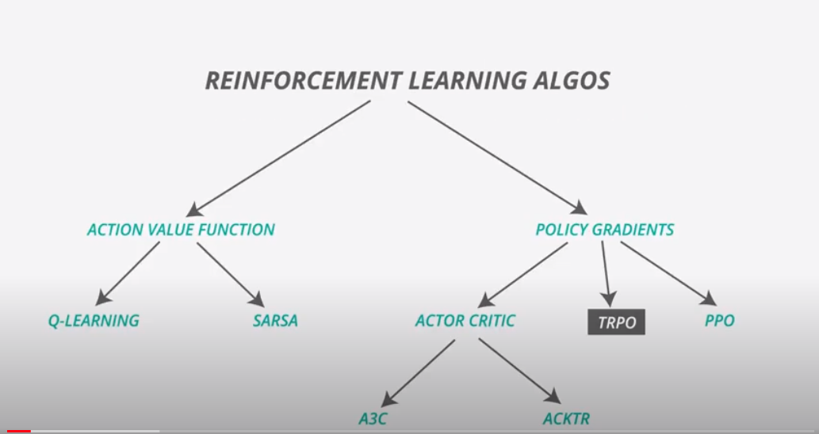
WHERE ARE WE?
This paper compares 2 policy gradient algorithms:
TRPO and PPO
Scott’s presentations so far cover Action Value

Slide 3
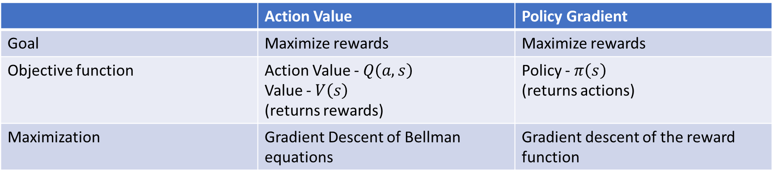
Action/Value vs. Policy Gradients
 | Action Value | Policy Gradient
Goal | Maximize rewards | Maximize rewards
Objective function | Action Value - $Q\left(a,s\right)$ Value - $V\left(s\right)$ (returns rewards) | Policy - $π\left(s\right)$ (returns actions)
Maximization | Gradient Descent of Bellman equations | Gradient descent of the reward function
Hold off on detailed explanations and comparisons

Slide 4
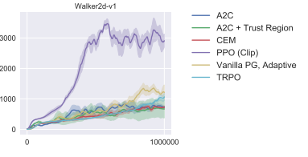
Review Focus
Most work in Policy Gradients is to both stabilize and speed up gradient descent
This paper reviews claims comparing 2 of these algorithms
Trust Region Policy Optimization (TRPO) – Schulman 2015
Proximal Policy Optimization (PPO) – Schulman 2017
In the 2017 paper, the authors demonstrate significant gains of PPO over TRPO (and other common algorithms)

Slide 5
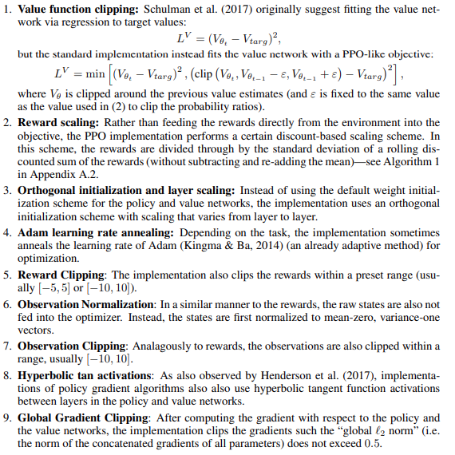
Reviewer’s Claims
Compared the codebases from TRPO and PPO papers
Found several optimizations that are independent of the core gradient descent modifications
Created new versions of the algorithms for more direct comparison
PPO-M – removes optimizations
TRPO+ - added all optimizations
Defined 2 metrics
average algorithmic improvement- AAI
average code-level improvement -ACLI

Slide 6
Results
Ran a series of RL benchmark tasks
Comparison of max rewards in table on top right
TRPO+ performs close or better than PPO
Compared improvement metrics
Most gains come from the optimizations
AGLORITHM | Gradient Constriant | Code Optimizations | WALKER2D-V2 | HOPPER-V2 | HUMANOID-V2
PPO | Clipping | Yes | 3292 | 2513 | 806
PPO-M | Clipping | No | 2735 | 2142 | 674
TRPO | Trust Region | No | 2791 | 2043 | 586
TRPO+ | Trust Region | Yes | 3050 | 2466 | 1030
AGLORITHM | WALKER2D-V2 | HOPPER-V2 | HUMANOID-V2
Algorithm Improvement | 242 | 99 | 224
Code Improvement | 557 | 421 | 444

Slide 7
Conclusions
Difficult to compare RL methods, even on standardized benchmarks
Code optimizations, not just algorithmic changes, impact overall performance
Code bases are not unified across the research
RL lacks a common platform for research and development
Pace of innovations is so fast
Competing deep learning frameworks
TensorFlow - Google
PyTorch – Facebook
Highlights the need for a RL toolkit or framework for comparing algorithms

Slide 8
Resources
Reference | Link
TRPO Paper | Trust Region Policy Optimization, Schulman et al. 2015
PPO Paper | Proximal Policy Optimization Algorithms, Schulman et al. 2017
Implantation Paper | Implementation Matters in Deep RL 2019
TRPO Overview | Trust Region Policy Optimization (OpenAI)
PPO Overview | Proximal Policy Optimization (OpenAI)
Implementation Code | https://github.com/implementation-matters/code-for-paper

